Slide 1
WELCOME TO NICE DENIM MILLS LIMITED
DMD & CEO : NUR-E-YASMIN FATIMA

Slide 2
TABLE OF CONTENTS
INTRODUCTION
01
Before starting our presentation
ABOUT US
02
What we do
OUR PRODUCTS
03
Our all products
SUSTAINABILITY'S & COMPLIANCE
04
Our environmental regulations
CAPACITY & MACHINERIES
05
Our products division
CONTACT US
06
Keep in touch

Slide 3
WE ARE WORLD CLASS
DENIM FABRIC MANUFACTURER
6 million yards of denim production monthly
Fabric composition of 100% cotton, cotton poly spandex, tencel denim, pure and blended viscose etc.
Latest Ozone machinery integrated into our Commercial Production
World class ETP Plant Facility
Environmentally compliant
CSR

Slide 4
PRODUCTS
RAW DENIM
BI–STRETCH
PRINTED DENIM
ECRU DENIM
ORGANIC DENIM
POLY COTTON
SLUB DENIM
MARBLE DENIM
COMFORT STRETCH
COTTON SERGE
COLORED DENIM
DOBBY DENIM
SUPER STRETCH
BULL DENIM
VISCOS DENIM
CHAMBRAY DENIM

Slide 5
BUYERS

Slide 6
ETP PLANT
SUSTAINABILITY'S & COMPLIANCE
The Effluent Treatment Plant Process facility in our factory allows us to do
our part in creating a more
sustainable and safer denim
production plant. Our plant
Drastically reduces and treats
chemical and water waste from
our factories and allows
reusable water to be used
again and discharged
safely back into
the natural
systems.

Slide 7
SUSTAINABILITY'S & COMPLIANCE
SUSTAINABILITY
NICE Denims adheres to worldwide environmental regulations. We believe in creating not only a better marketplace for our denim, but also better developed denim processes and products that ultimately save the environment and set a leading example for efficient and environmentally friendly manufacturing.

Slide 8
CSR
PRAYER ROOM
EMPLOYEE CHILD CARE
HYGIENIC & GOOD QUALITY FOOD
DINING FACILITY
MEDICAL CENTER & AMBULANCE
ATM BOOTH QUICK BANKING FACILITIES

Slide 9
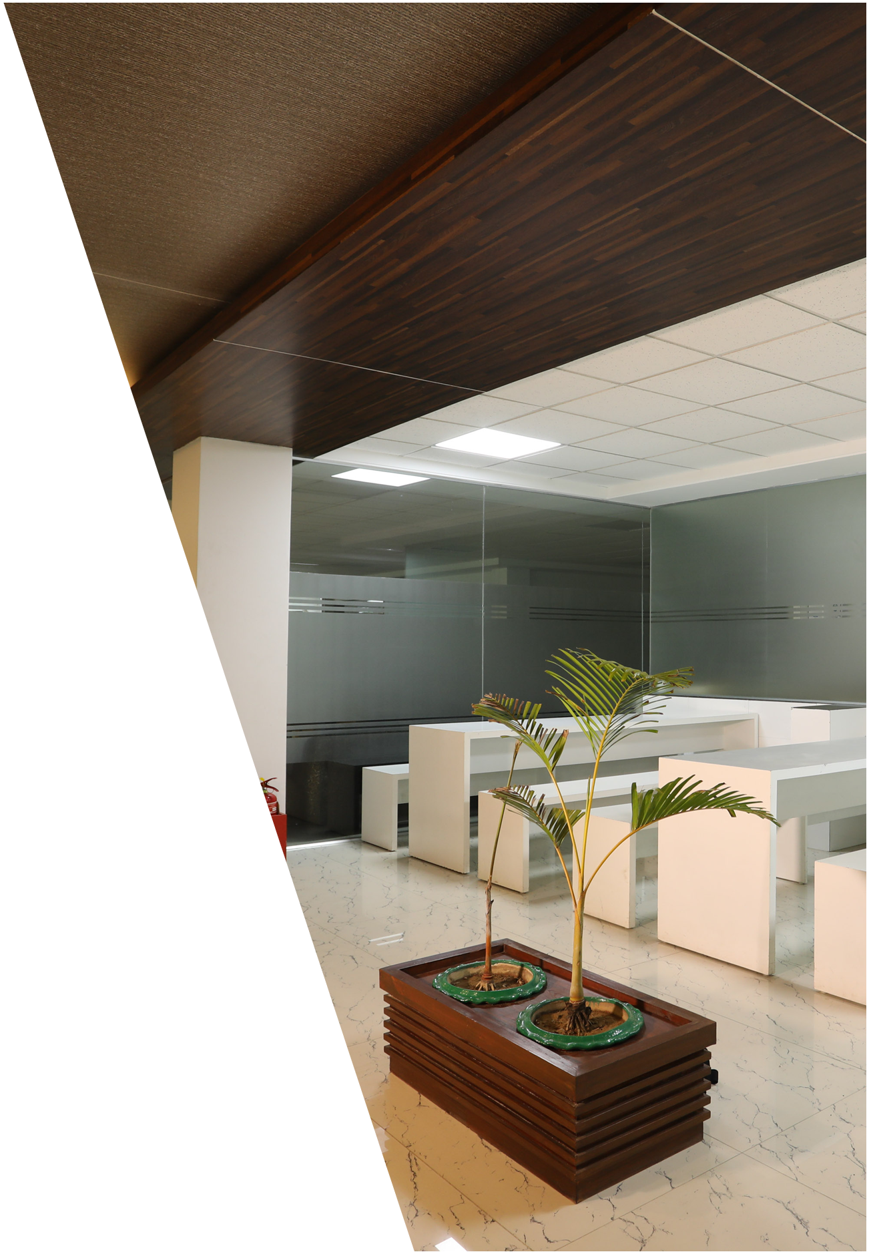
WORKER FACILITIES
All rooms are equipped for emergency evacuation
Proper lighting and ventilation for all workers and staff
Health facilities are provided with qualified & experienced physicians
Proper sanitation and hygiene for male and female workers
We have provided water filters so that workers may access drinking
water in multiple locations across the factory
30 first aid kits with proper equipment is provided
Fire pump and fire fighting equipment as per the Bangladesh Fire Service
& Civil Defense regulations are fully installed and functioning with
maintenance at our composite complex.
Our facility has a water reserve capacity of 100,000 Liters.

Slide 10
QUALITY ASSURANCE
NICE Denims operates under Top Quality Assurance Systems accepted internationally, and employs the American 4.0-point demerit inspection system to ensure 100% quality inspection. Our certifications include:
American Standards Textile Materials
GOTS & OCS Certification
OEKO-TEX Certification
ISO Standards
American Association of Textile Chemists and Colorists

Slide 11
CERTIFICATION
NICE Denims complies to the highest and strictest quality and compliance of denim manufacturing in the global market. Our assurance for high grade denim tested and made to conform to a class of sustainable consumer denim is reflected by our certifications. Our internal processes, teams and products are rigorously subjected to tests for quality control while maintaining a culture of safe, efficient and compliant work ethics that respect industrial, labor and environmental regulations.

Slide 12
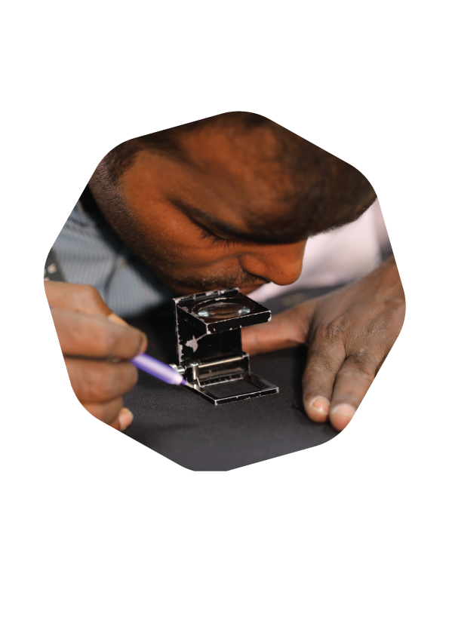
RESEARCH & DEVELOPMENT
Our Research and Development (R&D) procedures enables us to explore new opportunities with buyers by the most advanced fabric development with the latest washing and finishing techniques. Our R&D includes a sampling unit which hosts garment and leg panel samples and prototypes which are at the helm of NICE Denim’s vision for the future. Our design team exclusively generated applications, suggestions ranging from styling silhouettes to different finishes.
OUR LABORATORY IS ACCREDITED BY H&M.

Slide 13
PHOTO FROM
RESEARCH & DEVELOPMENT

Slide 14
CAPACITY & MACHINERIES
WE ARE INTRODUCING COMMERCIAL PRODUCTION WITH G 2 DYNAMIC EDGE 235 OXYGEN FINISH
SUSTAINABLE PROCESS
LESS WATER BETTER PERFORMANCE.
IMPROVE FABRIC PROCESS
SHORTER & FASTER.

Slide 15
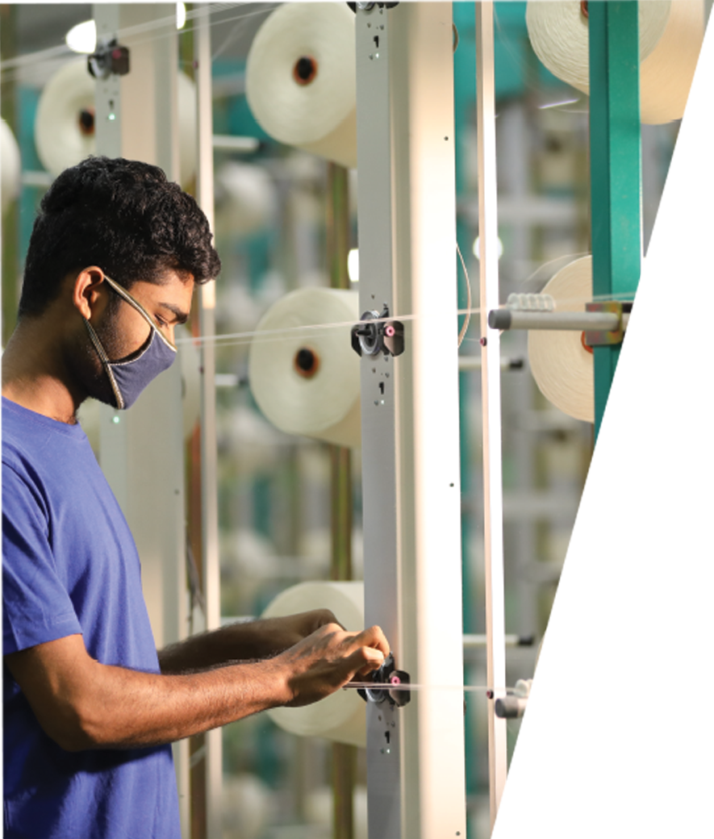
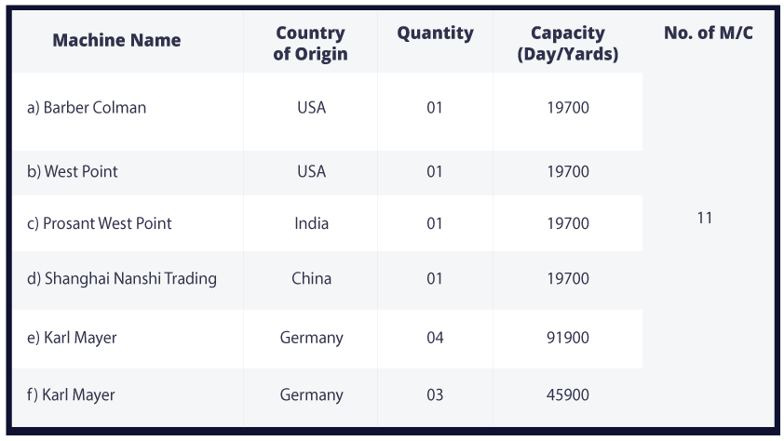
BALL WARPING
CAPACITY & MACHINERIES

Slide 16
BALL WARPING
www.nice-denim.com

Slide 17
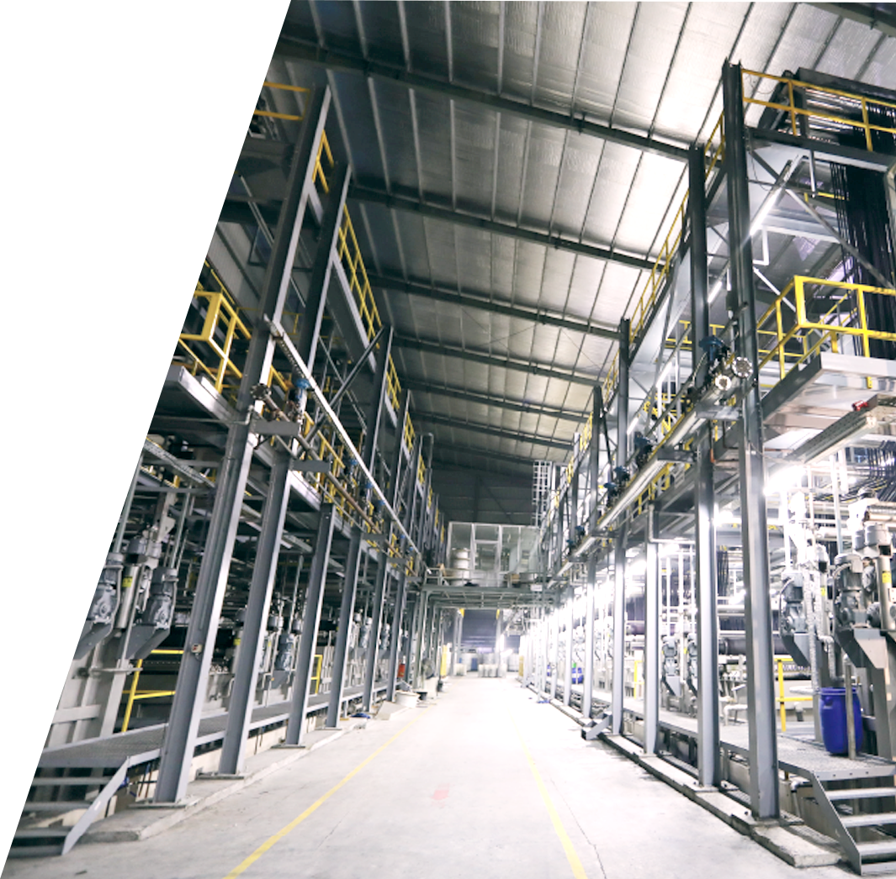
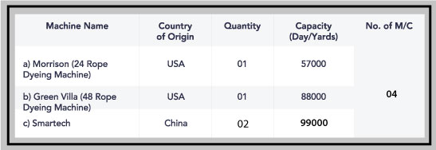
ROPE DYEING
CAPACITY & MACHINERIES

Slide 18
ROPE DYEING
www.nice-denim.com

Slide 19
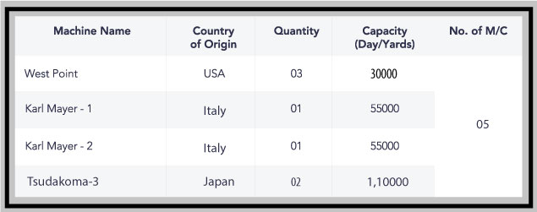
CAPACITY & MACHINERIES
L.C.B
SIZING

Slide 20
L.C.B

Slide 21
SIZING

Slide 22
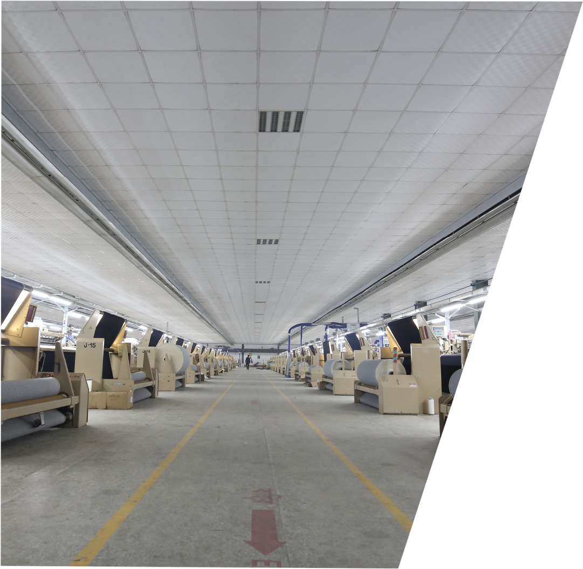
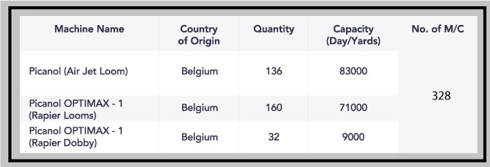
WEAVING
CAPACITY & MACHINERIES

Slide 23
WEAVING

Slide 24
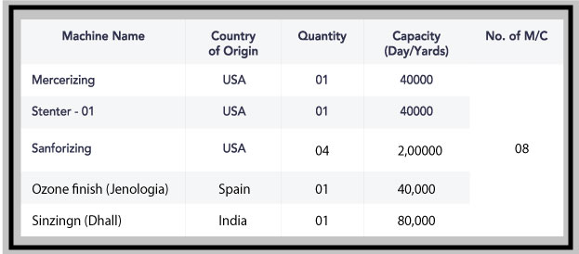
CAPACITY & MACHINERIES
FINISHING
INSPECTION

Slide 25
FINISHING

Slide 26
CONTACT INFORMATION
MARKETING OFFICE
Address: House-19 (a), Road-44, Gulshan-02, Dhaka-1212.
Email: info@nice-denim.com
Phone: 02-9853391, 02-9853392, 02-98534441
FAX: 02-9564336
FACTORY OFFICE
Address: MC Bazar, Mawna (Uttar para)
Sreepur, Gazipur, Bangladesh Email: info@nice-denim.com
Phone: 02-9578401-02-9578407-8
FAX: 02-9564336
facebook.com/nicedenimbd
twitter.com/nicedenim16
youtube.com/channel/UC3EsRSlmVEKUqde87-6aESQ

Slide 27
THANK YOU FOR WATCHING!
ANY QUESTIONS?
website- http://www.nice-denim.com
Facebook page: nicedenimbd
Twitter: nicedenim16

